Slide 1

PROTECTION: Root-of-Trust for IO in Compromised Platforms
Aritra Dhar, Enis Ulqinaku, Kari Kostiainen, Srdjan Capkun
ETH Zurich

Slide 2



Motivation
Remote device
Heart beat
75
Insulin (U)
177
Basal rate (U/Hr)
0.025
Low limit (mg/dL)
60
High limit (mg/dL)
105
Program
Cancel
Notes:
Just skim over the applications quickly with the desired properties. E.g., e-voting and crypto currency wallets require both integrity and confidentiality. Smart home, medical devices and industrial control systems requires integrity.

Slide 3








Remote Trusted path
User
HIDs
Host
Remote server
Notes:
Introduction to the trusted path. Local and remote versions. End points are trusted entities. For local trusted path, we need a trusted endpoint, a trusted software or a TEE enclave can serve the purpose. However for the remote trusted path, this is not require. However, in literature, usage of hypervisor, TEE is common as a trusted anchor on the local host while constructing trusted path to a remote server.

Slide 4

Solution 1: Transaction Confirmation Device
Remote device
Heart beat
75
Insulin (U)
177
Basal rate (U/Hr)
0.025
Low limit (mg/dL)
60
Android Protected Confirmation
You are going to program
Heart beat 75
Insulin 177U
Basal rate 0.025 U/Hr
Low level 60 mg/dL
High level 105 mg/dL
And mode ……
High limit (mg/dL)
105
Program
Cancel

Slide 5






Transaction Confirmation Devices: What is bad about it?
Habituation error
Bad Usability
Cannot handle
Complex UI

Slide 6

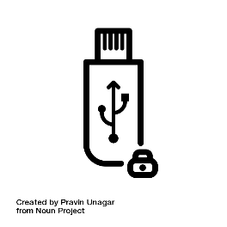
Solution 2: Input Signing
Remote device
Heart beat
75
Insulin (U)
177
Basal rate (U/Hr)
0.025
Low limit (mg/dL)
60
Trusted embedded device
High limit (mg/dL)
105
Program
Cancel

Slide 7




IntegriKey – Display manipulation attack
177
177
Insulin
1777
$$←$$
17
Insulin
177
User sees 177
Device records 17
Host sends 17

Slide 8
Observation 1
The lack of output integrity – the render of user inputs on the screen – compromises input integrity.

Slide 9

Solution 3: Overlay
Remote device
Remote device
Heart beat
75
Heart beat
Insulin (U)
177
Insulin (U)
Basal rate (U/Hr)
0.025
Basal rate (U/Hr)
Low limit (mg/dL)
60
Low limit (mg/dL)
High limit (mg/dL)
105
High limit (mg/dL)
Program
Cancel
Program
Cancel

Slide 10
Overlay: Output Manipulation
Remote device
Heart beat
Insulin (U)
Basal rate (U/Hr)
Low limit (mg/dL)
High limit (mg/dL)
Program
Cancel

Slide 11
Overlay: Output Manipulation
Remote device
Insulin (U)
Heart rate
Basal rate (U/Hr)
Low limit (mg/cc)
High limit (mg/cc)
Program
Cancel

Slide 12

Overlay: Output Manipulation
Remote device
Insulin (U)
177
Heart rate
75
Basal rate (U/Hr)
0.025
Low limit (mg/cc)
6000
High limit (mg/cc)
10500
Program
Cancel

Slide 13

Overlay: Output Manipulation
Remote device
Insulin (U)
177
Heart rate
75
Basal rate (U/Hr)
0.025
Low limit (mg/cc)
6000
High limit (mg/cc)
10500
Program
Cancel

Slide 14
Observation 2
If the protected output is provided out-of-context,
users are more likely not to verify it.
Therefore input integrity can be violated.

Slide 15
Overlay: Early Form Submission Attack
Remote device
Heart beat
75
Textbox in focus
Insulin (U)
17
Basal rate (U/Hr)
0.025
Low limit (mg/dL)
60
High limit (mg/dL)
105
OS triggers click
Program
Cancel
Notes:
Absence of the support for the mouse pointer may seem like a functional limitation but in creates security problem. .. <<Explain the early form submission attack briefly>>

Slide 16
Observation 3
If not all the modalities of inputs are secured simultaneously, none of them can be fully secured.

Slide 17




Requirements

Slide 18
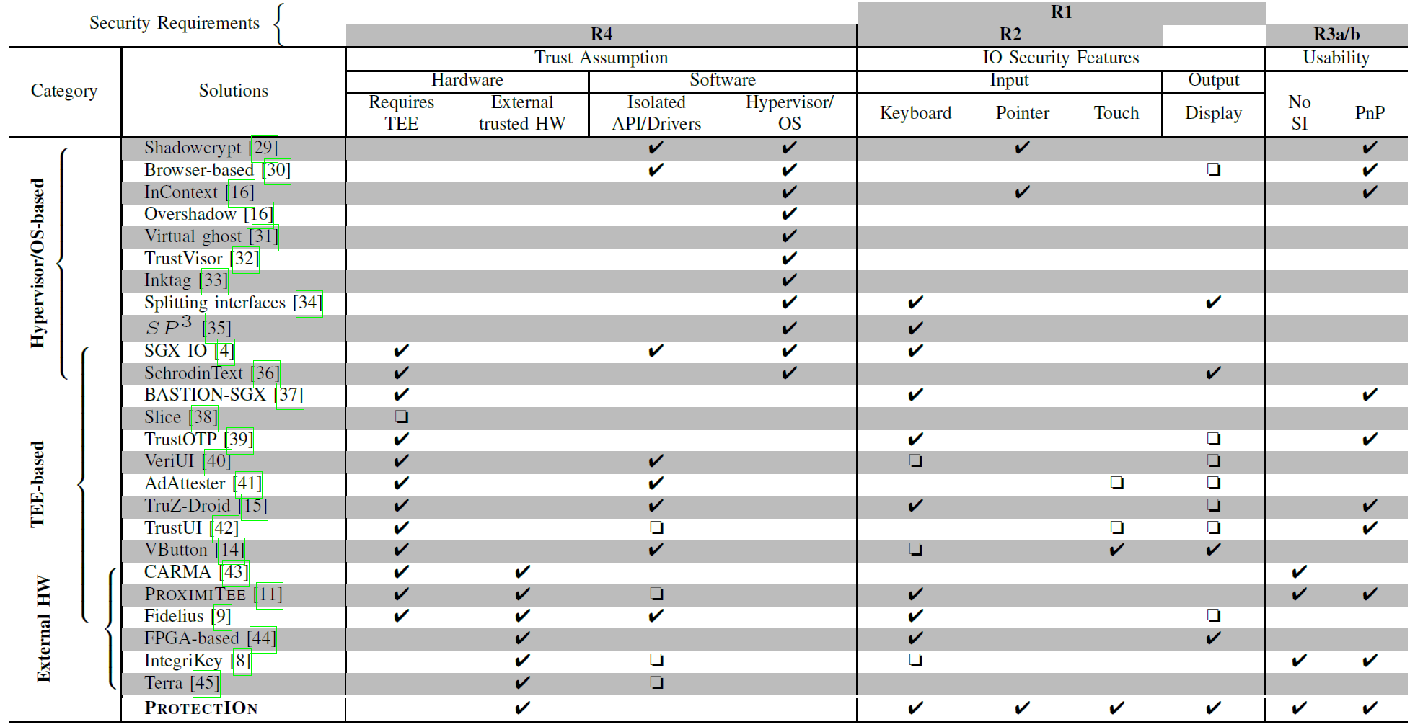
Other Trusted Path Solutions

Slide 19






ProtectIOn: High Level Approach
Server
Application level payload
IO second factor
Frames
Input forward
Host
IOHub
Input
Overlay

Slide 20
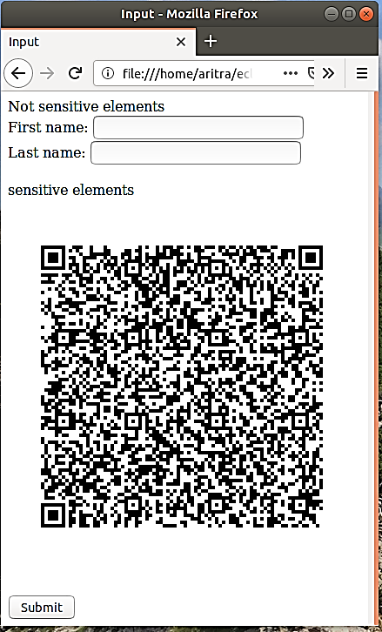
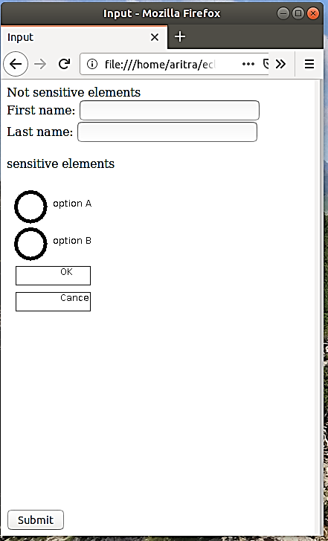

Approach Overview
Attacker’s view
User’s view on the monitor
Focusing user’s attention

Slide 21
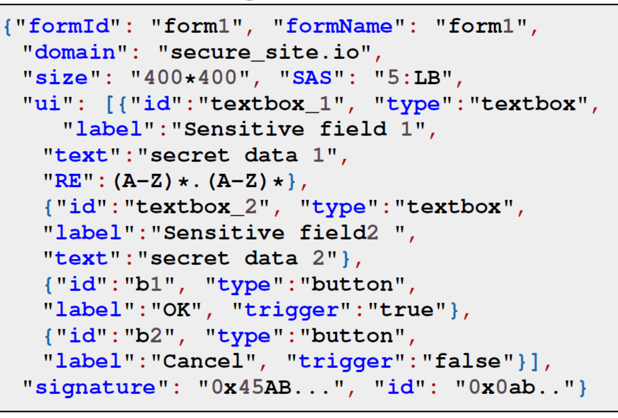

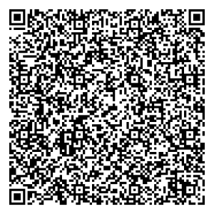
Overlay Generation:Specification
Sensitive form
Sensitive field 1
Sensitive field 2
OK
Cancel
Normal field

Slide 22
Overlay Generation
Sensitive form
Sensitive field 1
Sensitive field 2
OK
Cancel
Normal field

Slide 23

Overlay Generation
Sensitive form
Normal field

Slide 24

Overlay Generation
Sensitive form
Verified UI from secure_site.io
Sensitive field 1
Data_1
Sensitive field 2
Data_2
OK
Cancel
Integrity protected
Normal field

Slide 25

Overlay Generation
Sensitive form
Verified UI from secure_site.io
Sensitive field 1
Data_1
Sensitive field 2
Data_2
OK
Cancel
Integrity protected
Normal field
Sensitive field 1:Data_1
Sensitive field 2:Data_2
Action:OK
Sign(payload)
Payload

Slide 26
Grabbing User Attention
Output Integrity
Several existing mechanisms
Lightbox
Highlight
Freezing
Combinations of these methods

Slide 27
Grabbing User Attention
Output Integrity
Several existing mechanisms
Lightbox
Highlight
Freezing
Combinations of these methods

Slide 28
Grabbing User Attention
Output Integrity
Several existing mechanisms
Lightbox
Highlight
Freezing
Combinations of these methods

Slide 29
Grabbing User Attention
Output Integrity
Several existing mechanisms
Lightbox
Highlight
Freezing
Combinations of these methods

Slide 30
Grabbing User Attention
Output Integrity
Several existing mechanisms
Lightbox
Highlight
Freezing
Combinations of these methods

Slide 31
Grabbing User Attention
Output Integrity
Several existing mechanisms
Lightbox
Freezing
Highlight
Combinations of these methods
How to determine when to engage?
Track pointer
Mouse movement on the overlay

Slide 32
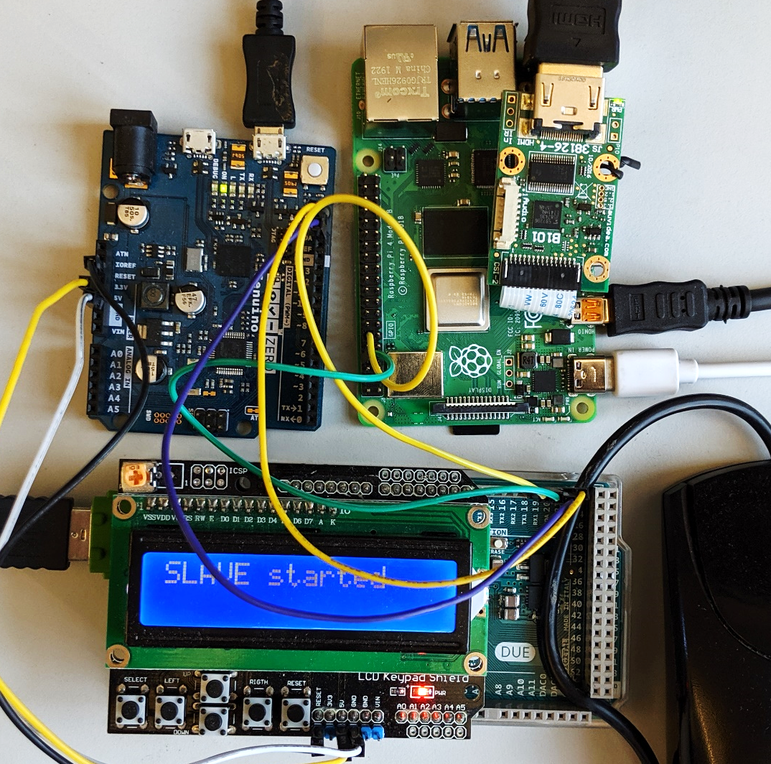
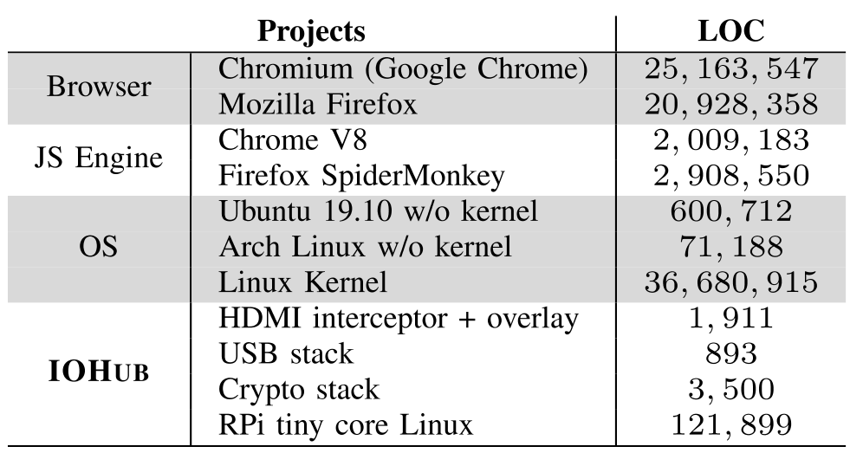
Prototype and TCB
Input Relay to the host
Overlay generator
Input hdmi
HDMI interceptor
HDMI relay
Mouse
Input interceptor

Slide 33
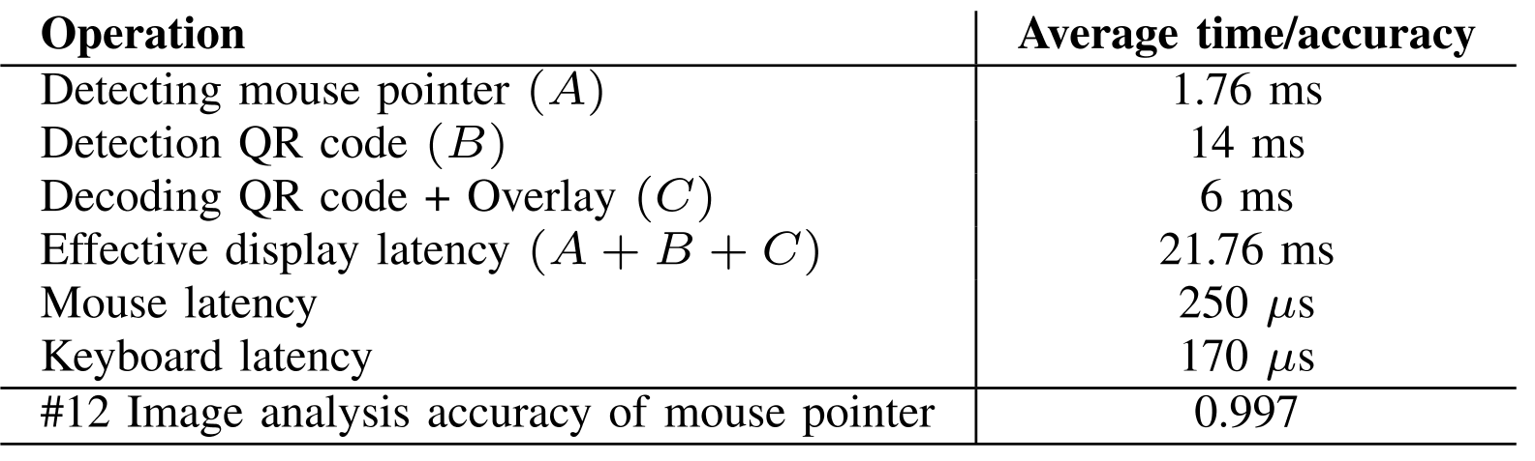
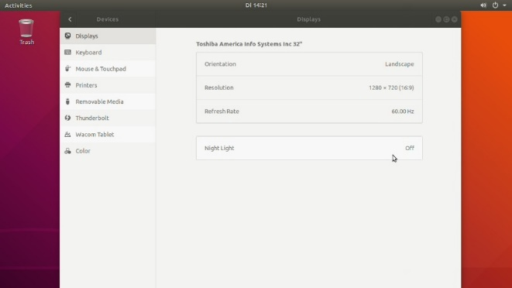
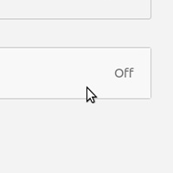
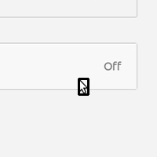
Performance

Slide 34
Thank you! Questions?

Slide 35
Solution 3: Overlay
Remote device
Remote device
Heart beat
75
Heart beat
Insulin
30
Insulin
Program
Cancel
Program
Cancel

Slide 36
Backup slides

Slide 37
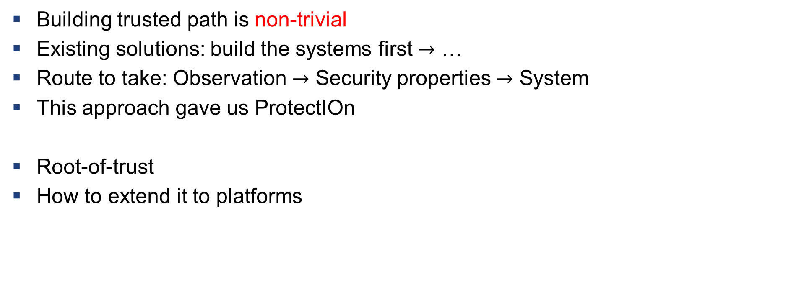
What we learnt?
Building trusted path is non-trivial
Existing solutions: build the systems first $→$ …
Route to take: Observation $→$ Security properties $→$ System
This approach gave us ProtectIOn
Root-of-trust
How to extend it to platforms

Slide 38
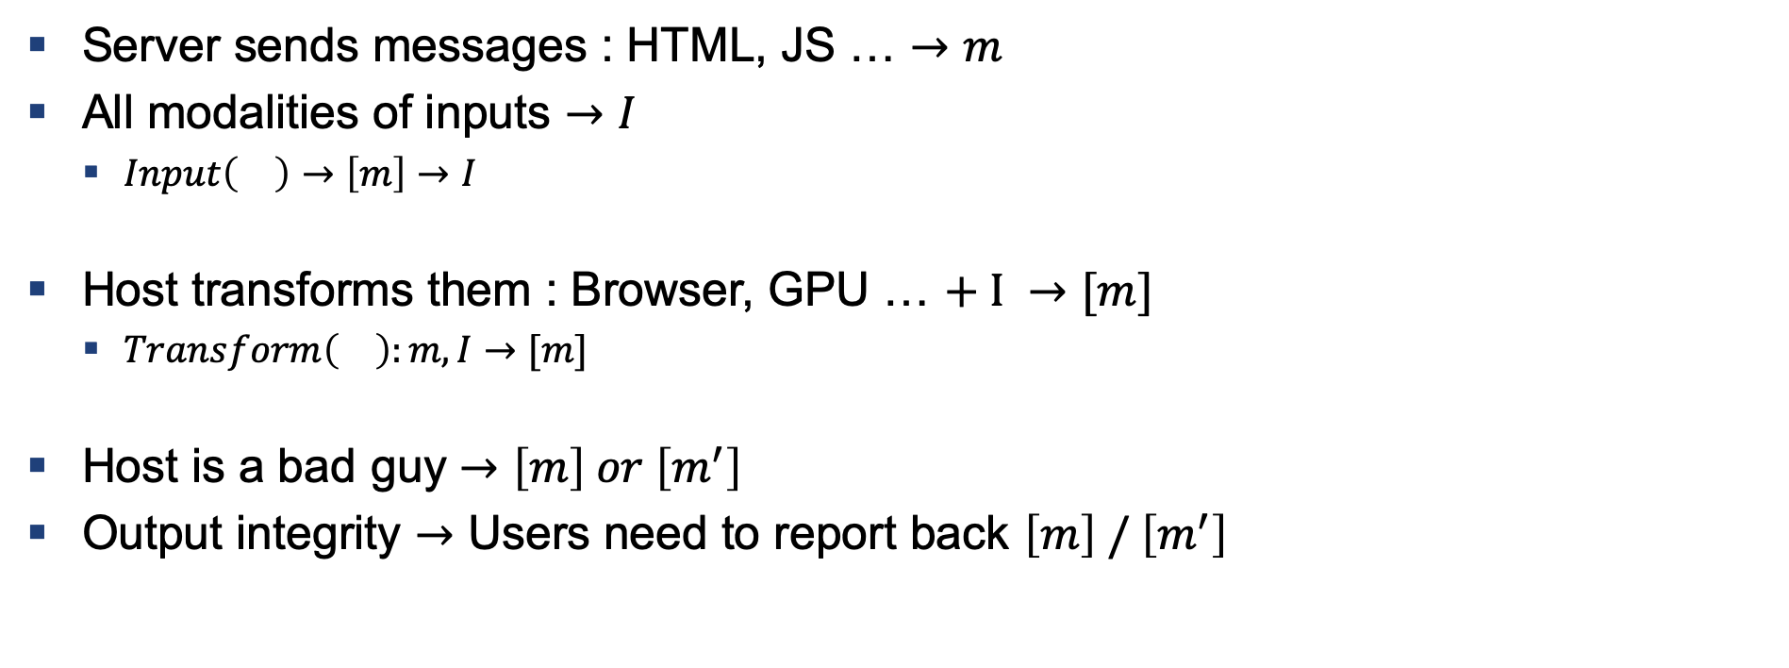
How to Build a Trusted Path
Server sends messages : HTML, JS … $→m$
All modalities of inputs $→I$
$Input\left(\right)→\left[m\right]→I$
Host transforms them : Browser, GPU … $+ I →[m]$
$Transform\left(\right):m,I→[m]$
Host is a bad guy $→\left[m\right] or \left[m^{′}\right]$
Output integrity $→$ Users need to report back $\left[m\right] / \left[m^{′}\right]$

Slide 39
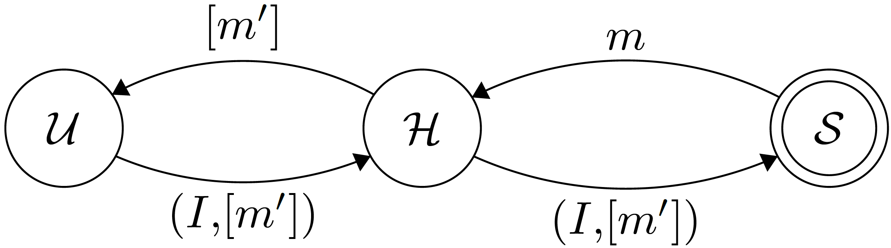
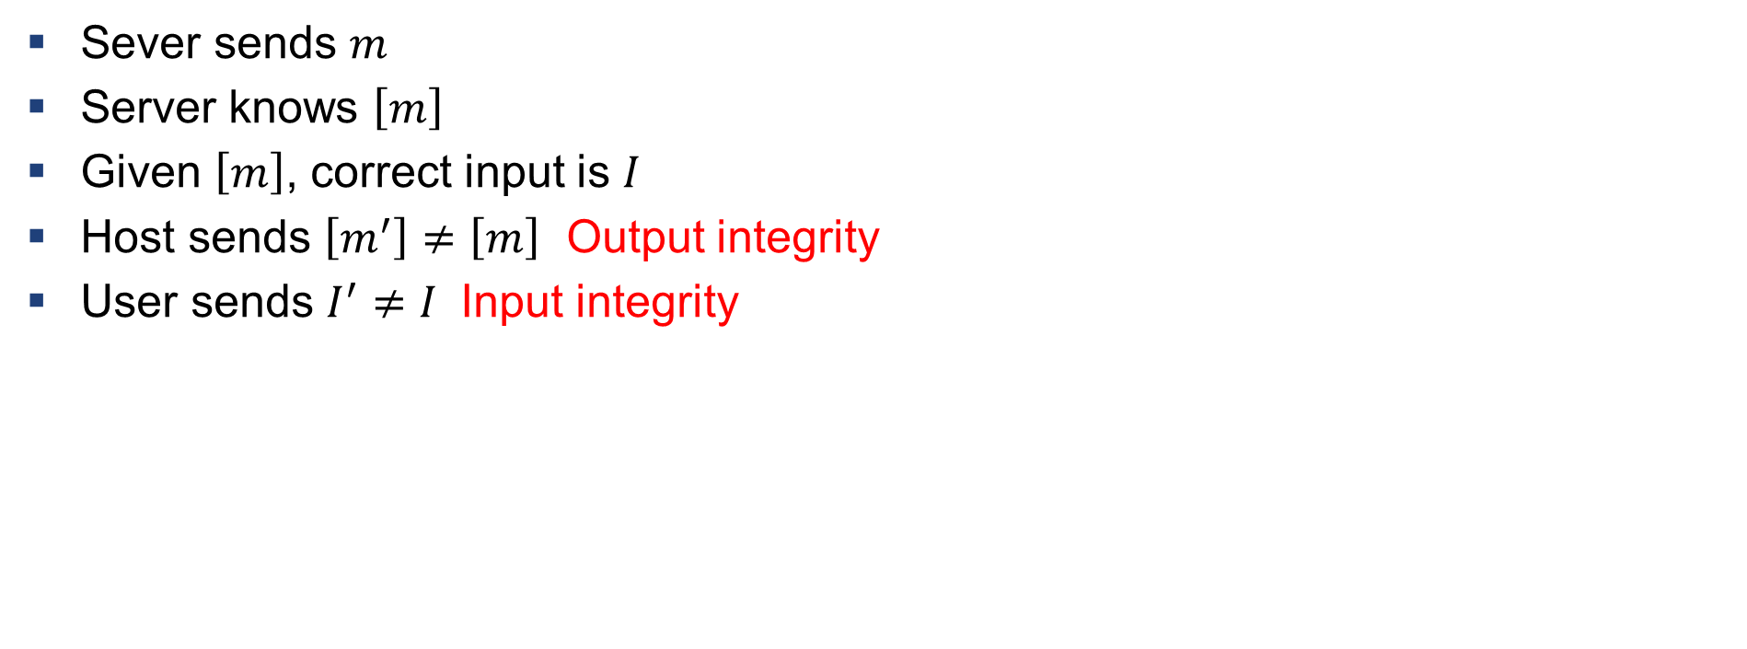
Definition: Violation of Input/output Integrity
Sever sends $m$
Server knows $\left[m\right]$
Given $\left[m\right]$, correct input is $I$
Host sends $\left[m^{′}\right]≠\left[m\right]$ Output integrity
User sends $I^{′}≠I$ Input integrity

Slide 40
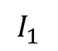
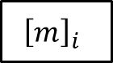
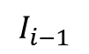
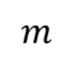
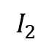
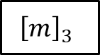
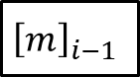
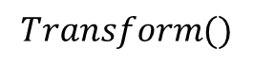
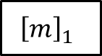
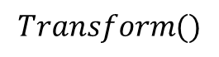
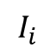
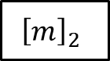

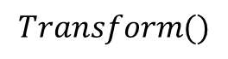
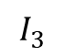
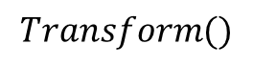
Verification
$$m$$
$$Transform()$$
$${\left[m\right]}_{1}$$
$${\left[m\right]}_{2}$$
$${\left[m\right]}_{3}$$
$${\left[m\right]}_{i−1}$$
$${\left[m\right]}_{i}$$
$$…$$
$$I_{1}$$
$$I_{2}$$
$$I_{3}$$
$$I_{i−1}$$
$$I_{i}$$
$$Transform()$$
$$Transform()$$
$$Transform()$$
Anything missing in the chain $→$ IO integrity violation

Slide 41
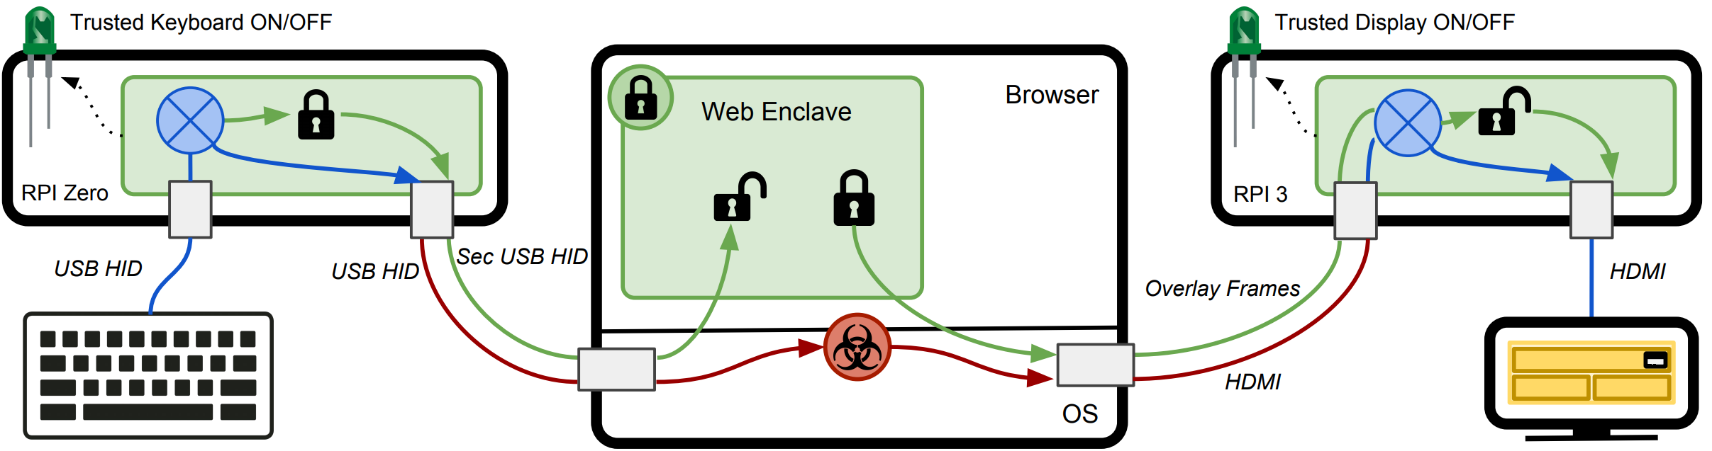
Fidelius – Output Integrity
Fidelius: Protecting User Secrets from Compromised Browsers, Saba Eskandarian et al., S&P 2018

Slide 42
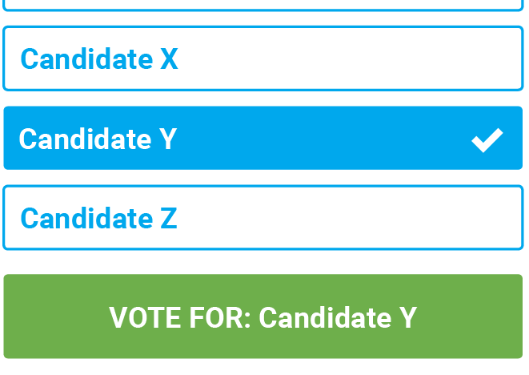
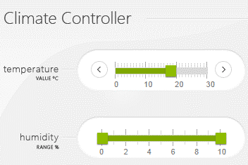
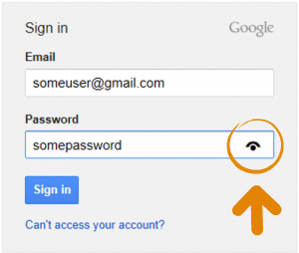
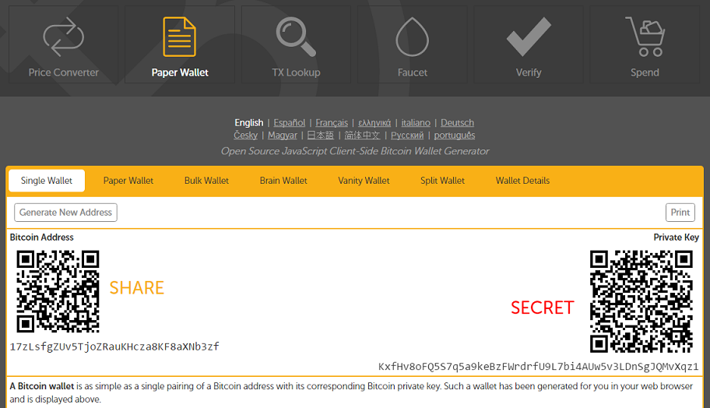
Motivation

